Slide 1
Trigonometry – The Sine Ratio
EQ: What is the sine ratio and how can I apply it to right angled triangle?

Slide 2
24
7
30
Trigonometry
Date:
EQ: What is the sine ratio and how can I apply it to right angled triangle?
Real life applications of trigonometry
Why use Trig?
The angle of direction and its length can be calculated to make tunnels started at opposite sides of a mountain meet at a centre.
Landscape surveyors often use trigonometry to assess the height of trees and buildings.

Slide 3

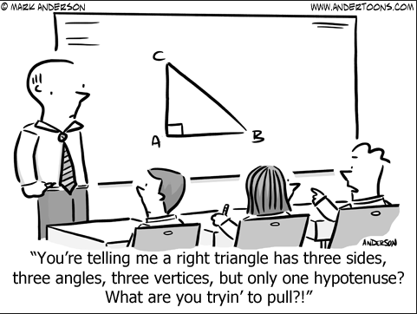

Slide 4

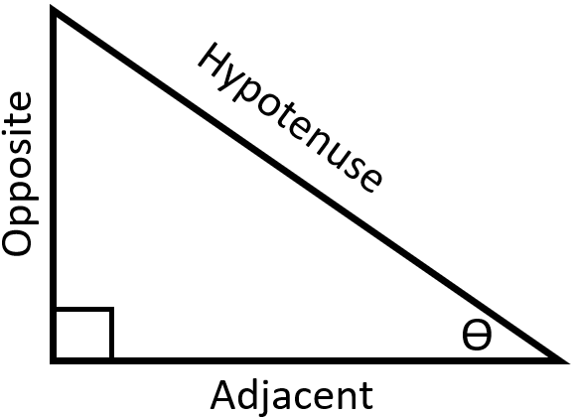
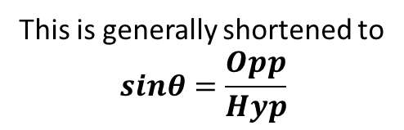
24
7
30
Trigonometry
Date:
EQ: What is the sine ratio and how can I apply it to right angled triangle?
Opposite side
What is the Sin Ratio?
Hypotenuse side
Sine of angle
This is generally shortened to
$$sinθ=\frac{Opp}{Hyp}$$

Slide 5
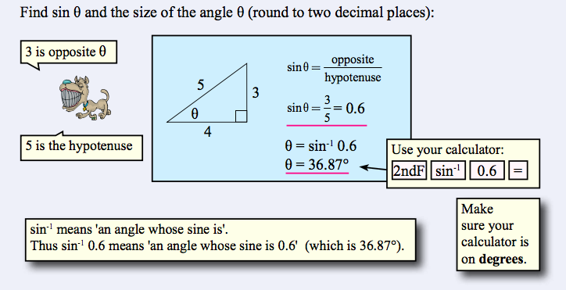
24
7
30
Trigonometry
Date:
EQ: What is the sine ratio and how can I apply it to right angled triangle?
What is the Sin Ratio and now how do I use it?

Slide 6
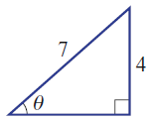
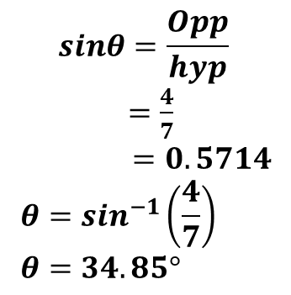
24
7
30
Trigonometry
Date:
EQ: What is the sin ratio and how can I apply it to right angled triangle ?
2nd example
For the example below find the size of the angle θ
What is the Sin Ratio and now how do I use it?
$$sinθ=\frac{Opp}{hyp}$$
$=\frac{4}{7}$
$$=0.5714 \\ θ=\sin^{−1}\left(\frac{4}{7}\right) \\ θ=34.85°$$
Hyp
Opp
This is θ = Shift or 2ndF sin⁻¹ (4/7)
Angle θ
Note we use (4/7) instead of 0.5714 because (4/7) is the exact number whereas 0.5714 is an approximation.

Slide 7
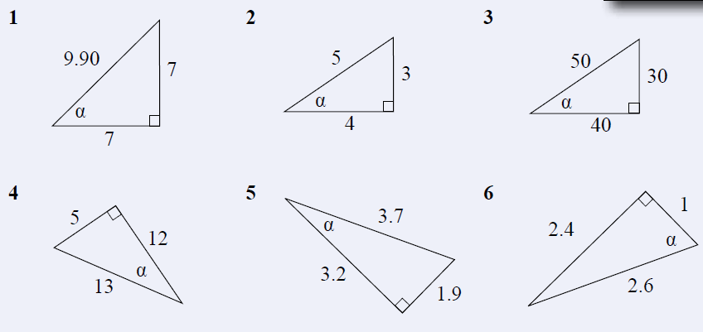
Now complete exercise 17.3 page 232 in the Dwyer Textbook Q1-6, see below and the worksheet 3a Trig – Sin ratio for finding an angle.
Please draw and label each triangle from the text to your Interactive Notebook.

Slide 8
Answers to Ex 17.3

Slide 9
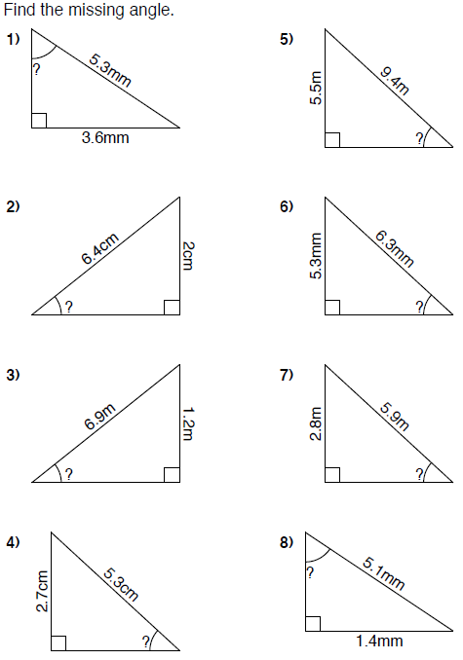

Slide 10
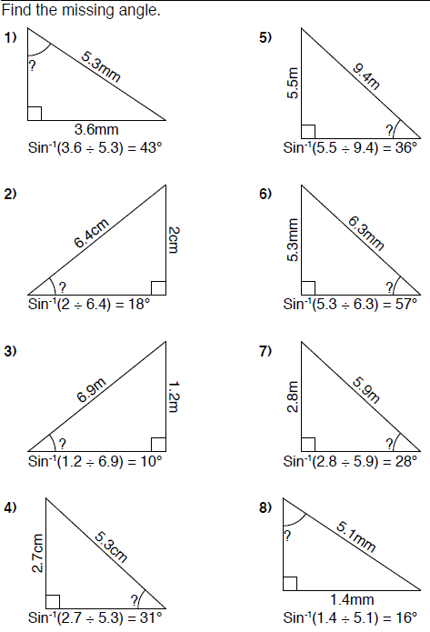
Answers

